Slide 1
MODULE 4
Design Issues – Threads – Process -Synchronization – Processor Scheduling – Memory Management – Virtualization – Types of Hypervisors – Para virtualization – Memory Virtualization – I/O Virtualization.

Slide 2
Operating System Design Issues
Encompasses all functional capabilities of the operating system of a multiprogrammed uniprocessor system.
It must be able to support concurrent task execution.
Should be able to exploit the power of multiple processors
Major design issues are:
Threads
Process synchronization
Process scheduling
Memory Management
Reliability & Fault Tolerance

Slide 3
Operating System Design Issues
Threads: The effectiveness of parallel computing depends greatly on the performance of the primitives that are used to express parallelism.
In order to avoid the overhead due to context switching, threads have been widely utilized to run applications concurrently
Process Synchronization: disabling the interrupts is not sufficient to synchronize concurrent access to shared data.
A more efficient synchronization mechanism has to be designed to maintain the performance of system.
Processor Scheduling: Processors should be utilized effectively in executing the tasks.
MP OS should be able to detect and exploit parallelism in the tasks being executed.

Slide 4
Operating System Design Issues
Memory Management: Virtual memory design is complicated as main memory is shared by many processors.
OS has to keep separate map table for each processor for address translation.
When several processors share same page, the OS must ensure consistency of their entries in respective map tables.
Reliability & Fault Tolerance: Multiprocessor OS should be able to handle system failures
It must provide reconfiguration schemes to reconstruct the system in the face of failures

Slide 5
THREADS
In multi processor systems it is often common to switch between the processes which implements parallelism.
But the overhead incurred due to context switching is a major concern as each process maintains a single address space.
To solve this issue threads or light weight processes were introduced.
Multiple threads can be associated with a process, each thread executes a specific portion of a program.
Each thread has its own program counter and a control block.
All the threads associated with a process share the same address space and all the information that is associated with the process is common to all the threads.
Maintaining same address space and sharing common information reduces the overhead incurred will creating a process and switching between the processes

Slide 6
Threads: User-Level threads
A run time library package provides routines for thread management.
Kernel intervention is not needed for the management of threads.
On top of a kernel implemented process, a large no: of user-defined threads are multiplexed.
Cost of a user level thread is low when compared to kernel level threads.
Kernel is unaware of presence of threads
Advantages of User level threads are:
No modifications are needed in existing OS kernel to support user level threads

Slide 7
Threads: User-Level threads
They can be customized to suit the needs of the users.
Different library packages available customized for different users, which removes the overhead of providing all capabilities in one package.
Disadvantages are:
There is a lack of co-ordination between scheduling and synchronization of threads executing parallel.
User threads require system calls be non-blocking.
If a thread blocks because of a system call, it will prevent other runnable threads from executing.

Slide 8
Threads: Kernel-Level threads
Kernel supports multiple threads per address space and provides operations for thread management.
Advantages are:
Co-ordination between synchronization and scheduling of threads is easy to achieve, as kernel has all information.
They are suitable for multithreaded applications, such as server processes, where interaction with the kernel are frequent.
Incur less overhead when compared to traditional processes.

Slide 9
Threads: Kernel-Level threads
Disadvantages:
Thread management operations incur higher overhead relative to user-level threads.
Kernel single handily manages the thread operations, which is responsible for providing any feature needed an applications
System developers favour user-level threads due to their excellent performance despite of their disadvantages.

Slide 10
Threads: First class threads
Introduced to overcome the problems associated with user level threads.
Thread package handles most of the thread operations such as creation, destruction etc.
Resource allocation and scheduling are handled by kernel
3 mechanisms are provided to communicate between the kernel and the thread package. They are:
1. Kernel and thread package share important data structures.
Kernel managed data is made available to thread package through read only access.
On the other hand through shared data structure, threads can communicate with the kernel.

Slide 11
Threads: First class threads
2. Kernel provides the thread package with software interrupts whenever a scheduling decision required.
When a thread blocks or resumes after blocking, the kernel delivers an interrupt that allows thread package to schedule an appropriate thread.
On interruption, a user level interrupt handler is activated, which handles scheduling
Scheduler interfaces enable sharing of data between dissimilar thread packages.
Interfacing occurs through thread scheduling routines, available in thread packages and listed in DS shared between kernel and thread package.

Slide 12
Threads: Scheduler Activations
Developed to overcome disadvantages of user-level threads.
Communication between kernel and user-level thread package is structured in terms of Scheduler activations.
A scheduler activation has 3 roles:
It servers as an execution context fro running user level threads
It notifies the user-level thread system of kernel events.
Provides space in kernel for saving the processor context of current user level thread,when the thread is stopped by the kernel.

Slide 13
Threads: Scheduler Activations
When a program starts, kernel creates a scheduler activation, assigns it to a processor and upcalls into program’s address space at fixed entry point.
A thread system on receiving upcall uses activation’s context to initialize and run’s program thread.
This thread may create additional threads and request additional processors.
For additional processor request, kernel will create a scheduler activation and assigns a processor to it.
No:of scheduler activations assigned to an application is equal to no:of processors assigned to the application.

Slide 14
Notifying Kernel Events to user level thread system
Kernel creates new scheduler activations to notify kernel events to user level thread system.
Case1: When a user level thread blocks in kernel space, kernel creates a scheduler activation to inform thread system about the blocked thread.
When a user-level thread that was stopped in kernel resumes, it may have to continue in kernel space.
The kernel resumes the thread until it blocks again or till it exists kernel space.

Slide 15
Notifying Kernel Events to user level thread system
Sometimes no processors will be available to assign activation, when kernel wants to notify an event to thread system.
Then kernel stops a thread belonging to an application to which the event has to be informed and uses that processor for notification.
Thus using scheduler activations kernels communicates with thread system.

Slide 16
Notifying USER LEVEL Events to THE KERNEL
The thread system notifies the kernel whenever the thread system enters a state where:
There are more processors than runnable threads
2. More runnable threads than no:of assigned processors

Slide 17
Process Synchronization- ISSUES

Slide 18
Process Synchronization
Execution of a concurrent program on multiprocessor system require processors to access shared data structures or access shared memory location.
There should be a mechanism to manage and serialize the access to data structures to ensure consistency.
This is the classic mutual exclusion problem, which is the basis of process synchronization.

Slide 19
Issues in Process synchronization
Solutions in uniprocessor system is not suitable for multiprocessor system, due to the excessive traffic by waiting processors.
Machine language instructions to perform atomic operations in a single memory location are included in multiprocessor systems
So,If the operation on shared memory is elementary, it can be embedded in a single atomic machine language instruction.
Thus mutual exclusion is implemented in hardware

Slide 20
Issues in Process synchronization
If several instructions are included in an access to shared data, primitives like lock and unlock(or P and V operations) are needed to ensure mutual exclusion.
Acquisition of a lock involves performing an elementary operation on a shared variable.
Atomic machine language instructions can be used to implement the lock operations, which automatically serializes concurrent attempts to acquire a lock

Slide 21
Process synchronization
Several atomic hardware instructions and approaches are available which can be used to implement P & V operations:
The Test and Set Instructions
The swap instruction
The Fetch and Add Instruction
SLIC Chip
Implementing process wait
Compare and swap instruction

Slide 22
1.TEST and SET Instruction
Atomically reads and modifies the contents of memory location in one memory cycle.
It is defined as: (m is memory location)
function Test-and-Set (var m:boolean):boolean;
begin
Test-and-Set :=m;
m:=true
end;
Above instruction can be used to implement p and V operations on a binary semaphore S.
P(S):while Test-and-Set(S) do nothing;
V(S):S:=false;

Slide 23
2.The SWAP INSTRUCTION
The swap instruction automatically exchanges the contents of 2 variables.(mem locations)
It is defined as:
procedure swap(var x,y:boolean);
begin
temp:=x;
x:=y;
y:=temp;
end:

Slide 24
2.The SWAP INSTRUCTION
P and V operations can be implemented using swap instruction in the following way
P(S):p=true;
repeat swap(S,p) until p=false;
V(S):S:=false;
Above discussed 2 implementations increases the traffic on the n/w due to busy waiting.

Slide 25
3.Fetch-And–ADD Instruction
A multiple operation memory access instruction that atomically adds a constant to a memory location and returns the previous contents of the memory location.
The instruction is defined as:
Function Fetch-and-Add(m: integer; c:integer);
var temp: integer;
begin
temp=:=m;
m:=m+c;
return(temp);
end;
This instruction is executed by hardware placed in interconnection n/w

Slide 26
3.Fetch-And–ADD Instruction
Fetch-and-Add instruction allows the implementation of P and V operations on a general semaphore S
P(S): while(Fetch-And-Add(S, -1)<0) do
begin
Fetch-And-Add(S,1);
while(S<=0) do nothing;
end;
V(s): Fetch-And-Add(S,1);
Notes:
Outer loop ensures only one processor succeeds in decrementing S to 0 when multiple processors are trying to decrement variable S.All unsuceesful processors add 1 to S and again try to decrement it.The second loop forces an uncessful processor to wait until S is greater than 0

Slide 27
4.SLIC CHIP (system Link & Interrupt Controller)
SLIC chip supports low level mutual exclusion along with many other functions.
An SLIC chip contains 64 single bit registers and supports the operations necessary for process synchronization.
Each processor has an SLIC chip and all SLIC chips are connected by a separate SLIC bus.
Each bit in the SLIC Chip called a gate acts as a separate lock and stores the status of the corresponding lock.
These 64 status bits are replicated over all processors there by reducing the traffic on the network.

Slide 28
4.SLIC CHIP (system Link & Interrupt Controller)
A processor executes lock-gate instruction to lock a gate.
The local SLIC of the processor attempts to close the gate by sending messages to other SLIC chips via SLIC bus.
Every SLIC chip will update its copy of the gate, when the status of a gate changes.
The code that implements P and V on a semaphore S is given as:
P(S):while(lock-gate(s)=failed) do nothing
V(s):unlock-gate(S);
As busy waiting is performed by checking the local SLIC, the SLIC bus is not overloaded.

Slide 29
5.Implementation of process wait
Concurrent execution in multiple processor environment causes several processors to wait for semaphore to open.’
There are 3 ways to implement this wait:
Busy waiting
Sleep-lock
Queueing

Slide 30
5.Implementation of process wait-
Busy waiting
Processors continuous execute atomic instructions to check for the status of shared variable
This approach causes wastage of processor cycles and increased network traffic.
Sleep-Lock
A process is suspended when it fails to obtain the lock
Suspended process become reactivated via interrupts, when lock is freed.
The process which frees the lock sends inter-processor interrupts to all suspended processors.
Reduces n/w traffic due to busy waiting

Slide 31
5.Implementation of process wait-
Queueing
A process waiting for a semaphore is placed on a global queue.
A V operation on semaphore de-queue the process.
Eliminates n/w traffic and wastage of processor cycles.
But introduces processing over head as enqueue and dequeue operation requires execution of several instructions

Slide 32
6. Compare and SWAP instruction
Synchronizes concurrent updates to a memory location
Compare-and-Swap(var r1,r2,m:integer);
var temp: integer;
begin
temp:=m;
if temp=r1 then{m:=r2; z=1}
else{r1:=temp; z:=0}
end;
r1 and r2 are registers and m is a memory location

Slide 33
Compare and Swap
Synchronize concurrent access to a shared variable, say m
Processor reads value of m into a register r1
Then a new value of is computed(say add x to original value) to be stored in m and place it in r2
Perform compare and swap
If z=1- no updates taken place to m, since processors last access .mutual exclusion maintained.
Z=0- m has been modified since last access by processor, new value of m stored in r1

Slide 34
Processor Scheduling

Slide 35
Processor Scheduling
In processor scheduling ready tasks are assigned to processors to improve performance
Tasks may belong to single program so may belong to different programs.
As tasks communicate through shared variables, processor scheduling in multi processor system is difficult

Slide 36
Issues in processor Scheduling
There are 3 major causes for performance degradation in multiprocessor systems.
Preemption inside Spinlock-controlled Critical sections
Occurs when a task is preempted inside critical section while other tasks are spinning the lock to enter same critical section
Wastage of cpu cycles by tasks as they continue to spin locks until pre-empted task is rescheduled and completes critical section.

Slide 37
Issues in processor Scheduling
2. Cache corruption
If the tasks executed successively by a processor come from different applications, on every task switch:
A big chunk on data belonging to previous task has to be removed from cache.
New data should be brought to cache.
This creates high miss ratio, which is called cache corruption and degrades performance.

Slide 38
Issues in processor Scheduling
3. Context Switching Overheads
Context switching results in the execution of a large no: of instructions to :
Save and store the registers
Initialize the registers
Switch address space.
This results in overhead and degrade the performance

Slide 39
Multiprocessor Scheduling Strategies
Some scheduling strategies to solve these issues are:
Co-scheduling
All runnable tasks of an application are scheduled on processors simultaneously.
When a task of the application needs to be pre-empted all tasks of that application are pre-empted.
Solves the problem of tasks wasting resources in lock-spinning ,while waiting for prempted task to release critical section.
Doesn’t solve cache corruption and context switching overheads.

Slide 40
Multiprocessor Scheduling Strategies
2. Smart Scheduling
Two nice features of this approach are:
Avoids pre-empting a task when it is inside the critical section
It avoids rescheduling of tasks that are busy waiting until the task that executes the corresponding critical section releases it
Solves the problem of tasks wasting resources in lock-spinning
Doesn’t solve cache corruption and context switching overheads.

Slide 41
Multiprocessor Scheduling Strategies
3.Scheduling in NYU Computer
Combines previous 2 scheduling strategies
Tasks are formed into groups and task group follow any of the following scheduling strategies:
Task can be scheduled or pre-empted in normal manner
All tasks in a group are scheduled or pre-empted simultaneously
Tasks in a group are never preemepted
Tasks can prevent its pre-emption irrespective of the group scheduling policy.
This causes efficient implementation of spin lock
Flexible as different scheduling strategies can be adopted by different groups

Slide 42
Multiprocessor Scheduling Strategies
4.Affinity Based Scheduling
Addresses the problem of cache corruption.
Task is scheduled on the processor where it is last executed.
A significant portion of task data will be present in the processor cache, when task is rescheduled.
System suffers load imbalance as task cannot be scheduled on any processor.

Slide 43
Design Issues in Memory Management
Some of the design issues in memory management are:
Portability: The virtual memory system relies heavily on the underlying architecture, which affects the portability of operating system.
Data Sharing: The virtual memory system should provide facility for data sharing which is needed for parallel execution of programs.
Protection: As memory is shared among several processes, the operating system should provide mechanism that a virtual memory system can use to protect memory objects against un authorized access.
Efficiency: virtual memory system should be efficient in performing address translation, page replacements etc. to maintain the efficiency of multiprocessor system

Slide 44
Memory Management in MACH OS
Mach operating system was designed to support multiprocessing.
Its multiprocessing capability is flexible, ranging from shared memory systems with no memory shared b/w processors.
The virtual memory system of Mach is designed to overcome many of the memory management design issues :
It provides primitives that provides tasks with permission to access the address space of other tasks.
Two protection codes named current protection and maximum protection are specified at page level to ensure the memory protection.

Slide 45
Memory Management in MACH OS
Mach virtual memory system achieves the goal of machine independence through splitting the implementation into 2 parts:
Machine independent part: maintains high level machine independent data structures
Machine dependent part: Manages the physical address space, like setting up page tables, page mapping etc.
Mach virtual memory system allows sharing of memory through inheritance mechanism.
The inheritance attribute of a page can take 3 values: none, copy,share.

Slide 46
Memory Management in MACH OS
None mode: child task cannot inherit the page of other task
Copy mode: copies the page of other task(parent) and modifications made in the page by the new task affect only that task.
Shared mode: Same copy of page is shared among different tasks. Modifications done to the page are seen by each task

Slide 47
Structure of multiprocessor OS
Depending upon the control structure and its organisation the three basic types of multiprocessor operating system are:
1) Separate supervisor
2) Master-slave
3) Symmetric Supervision

Slide 48
Separate Supervisors
Each processor behaves independently.
Each system has its own operating system which manages local input/output devices, file system and memory etc.
The access protection is maintained, between processor, by using some synchronization mechanism like semaphores.
Such architecture will face the following problems:
1) Little coupling among processors.
2) Difficulty in parallel execution of single task.
3) During process failure it degrades.
4) Inefficient configuration as the problem of replication arises between supervisor/kernel/data structure code and each processor.

Slide 49
Master Slave Configuration
Out of many processors one processor behaves as a master whereas others behave as slaves.
The master processor is dedicated to executing the operating system.
It works as scheduler and controller over slave processors
Slave processors are often identified as a schedulable pool of resources by master.
Allows the parallel execution of a single task by allocating several subtasks to multiple processors concurrently.
OS is highly susceptible to the failure of master processor

Slide 50
SYMMETRIC Configuration
All processors are autonomous and treated equally.
There is one copy of kernel that can be executed by all processors concurrently.
The concurrent access to shared data structures of supervisor needs to be controlled .
The simplest way to achieve this is to treat the entire operating system as a critical section and allow only one processor to execute the operating system at one time.
This method is called ‘floating master’ method .
Most flexible and versatile configuration
Allows parallel execution of tasks and efficient use of resources.

Slide 51
VIRTUALIZATION
Allows a single computer to host multiple virtual machines, each potentially running a different operating system.
Different servers can run on different virtual machines.
A failure in one virtual machine does not automatically bring down any others.
Also require fewer physical machines and saves money on hardware.
Migrating virtual machines is much easier than migrating processes running on a normal operating system.
While migrating a virtual machine, all that has to be moved is the memory image.

Slide 52
VIRTUALIZATION
Another use for virtual machines is to run legacy applications on operating systems which is no longer supported or which do not work on current hardware.
Another important use of virtual machines is software development.
S/w developer creates a dozen virtual machines on a single computer and installs different operating systems on each one and run all of them at once.

Slide 53
Hypervisors
A hypervisor is a crucial piece of software that makes virtualization possible.
It abstracts guest machines and the operating system they run on, from the actual hardware.
Hypervisors create a virtualization layer that separates CPU / Processors, RAM and other physical resources from the virtual machines you create.
The machine we install a hypervisor on is called a host machine.
Hypervisors emulate available resources so that guest machines can use them.

Slide 54
Hypervisors
There are two approaches to virtualization:
Type 1 Hypervisor
Type 2 Hypervisor

Slide 55
Type 1 Hypervisor
A Type 1 hypervisor is a layer of software we install directly on top of a physical server and its underlying hardware.
There is no software or any operating system in between.
Type 1 hypervisor is proven in providing excellent performance and stability since it does not run inside any operating system.
In reality, it is the operating system, since it is the only program running in kernel mode.

Slide 56
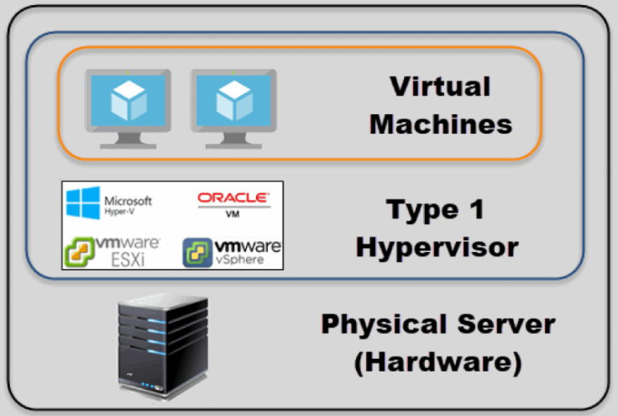
Type 1 Hypervisor

Slide 57
Type I hypervisor is to support multiple copies of the actual hardware, called virtual machines, similar to the processes a normal operating system supports.
The operating system running on top of the hypervisor is called the guest operating system.

Slide 58
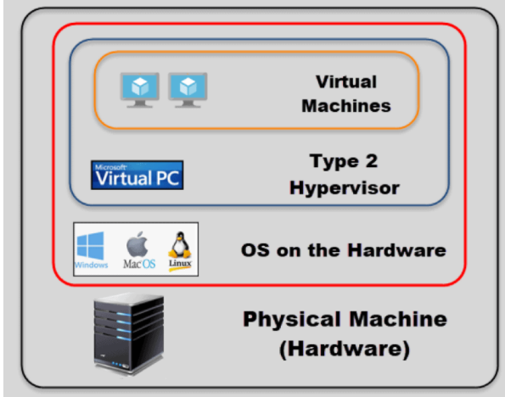
Type 2 Hypervisor
This type of hypervisor runs inside of an operating system of a physical host machine.
As opposed to type 1 hypervisors that run directly on the hardware, hosted hypervisors have one software layer underneath.
Operating system running on the hardware is called
the host operating system.

Slide 59
Type 2 Hypervisor
Type 2 hypervisors are typically found in environments with a small number of servers.
Advantage is that you do not need a management console on another machine to set up and manage virtual machines.
You can do all of this on the server where you install the hypervisor
They are not any different from the other applications you have in your operating system.
Hosted hypervisors essentially also act as management consoles for virtual machines, you can perform any task using the built-in functionalities.

Slide 60
Type 2 Hypervisor
Type 1 hypervisors can dynamically allocate available resources depending on the current needs of a particular VM.
But, a type 2 hypervisor occupies whatever you allocate to a virtual machine.
Should be careful to avoid over-allocating resources and crashing the host machine.
Type 2 hypervisors are convenient for testing new software and research projects.
Notes:
possible to use one physical machine to run multiple instances with different operating systems to test how an application behaves in each environment or to create a specific network environment.
You only need to make sure that there are enough physical resources to keep both the host and the virtual machines running.

Slide 61
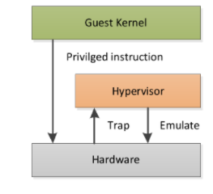
Paravirtualization
The disadvantage of type I and type 2 hypervisors in handling sensitive/privileged instructions resulted in the paravirtualization concept.
In type 1 and type 2 hypervisor approaches, the guest OS is completely isolated by the virtual machine from the virtualization layer and hardware.
There are multiple guest operating systems execute on a single host operating system in an isolated manner using direct execution and binary translation.
So to execute privileged instructions the guest OS needs to communicate directly
with underlying system hardware –(known as binary translation),which is
a sophisticated process.

Slide 62
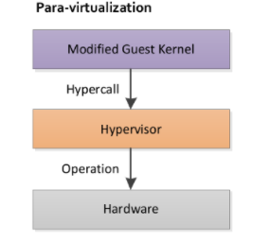
Paravirtualization
In paravirtualization, guest OS is not completely isolated but it is partially isolated by the virtual machine from the virtualization layer and hardware.
Virtualization method modifies the guest operating system to communicate with the hypervisor.
There is communication between the guest OS and the hypervisor to improve performance and efficiency.
Hypervisor defines an interface consisting of a set of procedure calls.
The guest operating systems can execute sensitive instructions by making
hypercalls through the interface.

Slide 63
Memory Virtualization
Involves sharing the physical system memory and dynamically allocating it to virtual machines.
Virtual machine memory virtualization is very similar to the virtual memory support provided by modern operating systems.
Applications see a contiguous address space that is not necessarily tied to the underlying physical memory in the system.
OS uses page tables to map virtual page numbers to physical page numbers.
To run multiple virtual machines on a single system, another level of memory virtualization is required.
We need to virtualize the MMU to support the guest OS

Slide 64
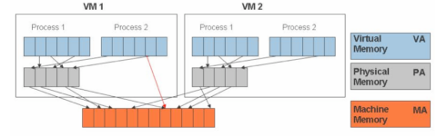
Memory Virtualization
The guest OS continues to control the mapping of virtual addresses to the guest memory physical addresses.
But the guest OS cannot have direct access to the actual machine memory.
The VMM(Virtual Machine Manage) is responsible for mapping guest physical memory to the actual machine memory, and it uses shadow page tables to accelerate the mappings.

Slide 65
I/O Virtualization
The hypervisor provides info about the I/O device attached and guest OS will load device drivers for the same.
Through the device drivers ,they perform I/O operation.
Since there are multiple virtual machines associated ,the hypervisor create a file or region on the actual disk for each virtual machine's physical disk.
Hypervisor is also capable of managing the hardware upgradation without the change in s/w.
A different approach to handling I/O is to dedicate one of the virtual machines to running a standard operating system and reflect all I/O calls from the other ones to it.
This approach is enhanced when paravirtualization is used, where the guest OS communicates with the hypervisor.
The virtual machine that does I/O called domain 0.

Slide 66
I/O Virtualization
I/O virtualization is an area in which type 2 hypervisors have a practical advantage over type 1 hypervisors:
The host operating system contains the device drivers for all the I/O devices attached to the computer.
In a type 1 hypervisor, the hypervisor must either contain the driver itself, or make a call to a driver in domain 0,

